Slide 1


Minor Project
Title:
BidNest:An online auction system
Presented by:
Vaibhav Rawat, R2142211074, CSE DevOps
Anushk Sanghvi, R2142210323 , CSE DevOps
Sanskar Sidodia, R2142210696 , CSE DevOps
Hammad Siddiqui, R2142210134 , CSE DevOps
Guided by:
Mr. Amrendra Tripathi
School of Computer Science

Slide 2
Content
Introduction
Problem Statement
Motivation
Objectives
Tech Stack
Methodology
Application of the Project
PERT Chart
References

Slide 3
1. Introduction
bidNest is an online platform that provides people to buy and sell items like in an auction like environment wherein customers compete to get the product.
This helps the seller get the maximum value for their products

Slide 4
2. Problem Statement
When we want to sell anything online, we don’t know what is the price we should get for it and even if we set a price there might be people who would have been interested in paying more to us as that item may be worth more to them due to which the seller does the get the maximum value for their products. The offline auctions need a lot of time to be invested for participation as people need to travel and then stay for all the items to come for the auction they are interested in and these auctions may also be geographically distant from people and even if people attend it they may not find the products they may be looking for or the sellers might find their items remained unsold.

Slide 5
3. Motivation
// kr lo

Slide 6
4. Objectives
To create a user friendly onine platform for auction.
To give people more value for their time.
To develop home page, browsing catalogue and other important functionalities

Slide 7
5. Technology Stack
Version Control
Github
Development
Backend – NodeJS
Frontend - ReactJS , HTML, CSS
Database
MongoDB

Slide 8
6. Methodology
Using ReactJS and NodeJS to implement // aise hi aage kr lena

Slide 9
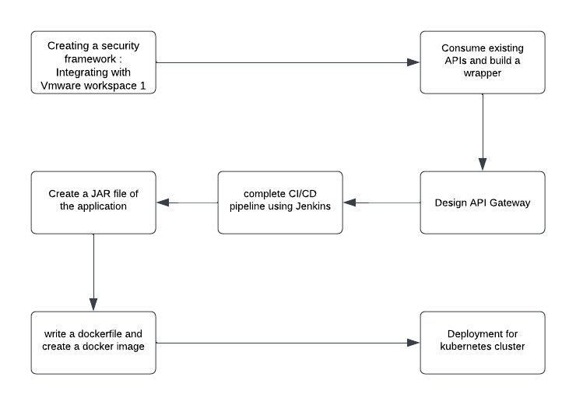
6. Methodology (contd.)
Fig.1 Methodology Chart

Slide 10
6. Methodology (contd.)
6.4 Triaging
The vulnerabilities found in the artifacts that a developer is working on are listed on the developer’s UVRMS portal
Developer can either mark the vulnerabilities as remediated (solve the issue) or mark them a False Positive or Action
Depending on the Triage Action taken by the developer the status is updated and vulnerability is sent to application owner or security team for approval.
The security team makes the final call for triaging a vulnerability.

Slide 11
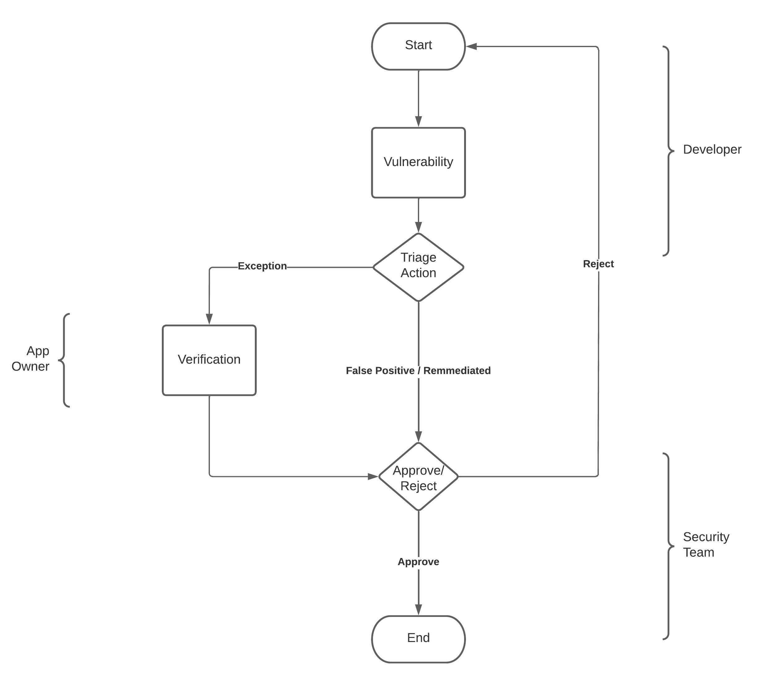
6. Methodology (contd.)
Fig.2 Triaging Workflow

Slide 12
8. Application of the Project

Slide 13

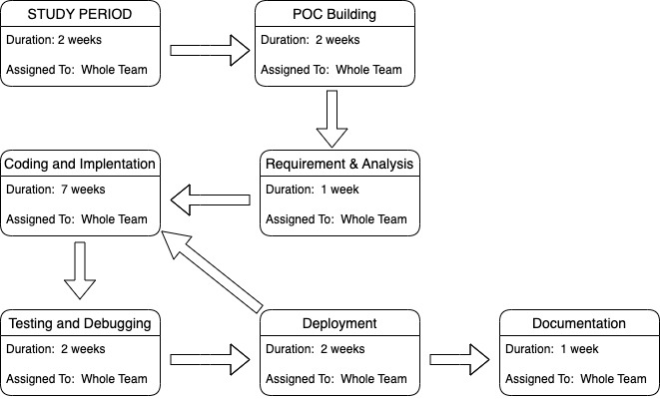
8. PERT Chart
Fig.6 Program Evaluation Review Technique Chart

Slide 14
10. References

Slide 15
Thank You

